Slide 1
EVENT MANAGEMENT SYSTEM
Team Details:
2310992560 Vinay
2310992562 Vivek
2310992563 Vrinda
2310992554 Vansh
Faculty Coordinator: Dr. Shivani
Mr. Nitesh Kumar
:
Chitkara University Institute of Engineering and Technology,
Chitkara University, Punjab

Slide 2
Table of Contents
Introduction
Problem Statement
Technical Details
Key Features
Project Highlights
Future Scope
Conclusion
References/Links used

Slide 3
Introduction
A web-based platform to manage college events, registrations, and communication.
Built using Node.js + Express, MongoDB, Redis, and WebSockets for real-time updates.
Provides centralized event info, role-based access, and instant notifications.
Supports real-time event chat rooms and organizer-to-student messaging.
Reduces manual work and improves student participation through quick, automated updates.

Slide 4
Problem Statement
Event management at colleges is hampered by inefficient manual processes, such as paperwork and physical notices, which are time-consuming and error-prone.
There is a communication gap between organizers and students, resulting in low awareness and poor participation.
Information about events is scattered and decentralized, making it hard for students to find reliable, up-to-date details.
Limited accessibility of traditional communications restricts students’ ability to access event information, especially those off-campus.

Slide 5
Technical Details
Backend: Node.js with Express.js for building the server and API routes.
Database: MongoDB with Mongoose for schema modeling and data management.
Authentication: JSON Web Tokens (JWT) for secure sessions + password hashing for user credential protection.
API Architecture: Fully RESTful API with structured endpoints for users, events, and registrations.
Caching Layer: Redis for fast data retrieval and performance optimization.
Real-time Communication: WebSocket(WS) for live event updates, organizer-to-student messaging, and event chat rooms.

Slide 6
Key Features
Centralized Event Portal: A single platform displaying all upcoming and ongoing college events.
Event Management: Full event CRUD functionalities available for organizers.
Secure Login: Authentication implemented using JWT .
Redis Caching: Faster event retrieval using the cache-aside pattern.
Real-Time Alerts: WebSocket-based live updates for announcements and event changes.
Scalable Architecture: Decoupled API, WebSocket server, and worker services for seamless horizontal scaling.

Slide 7
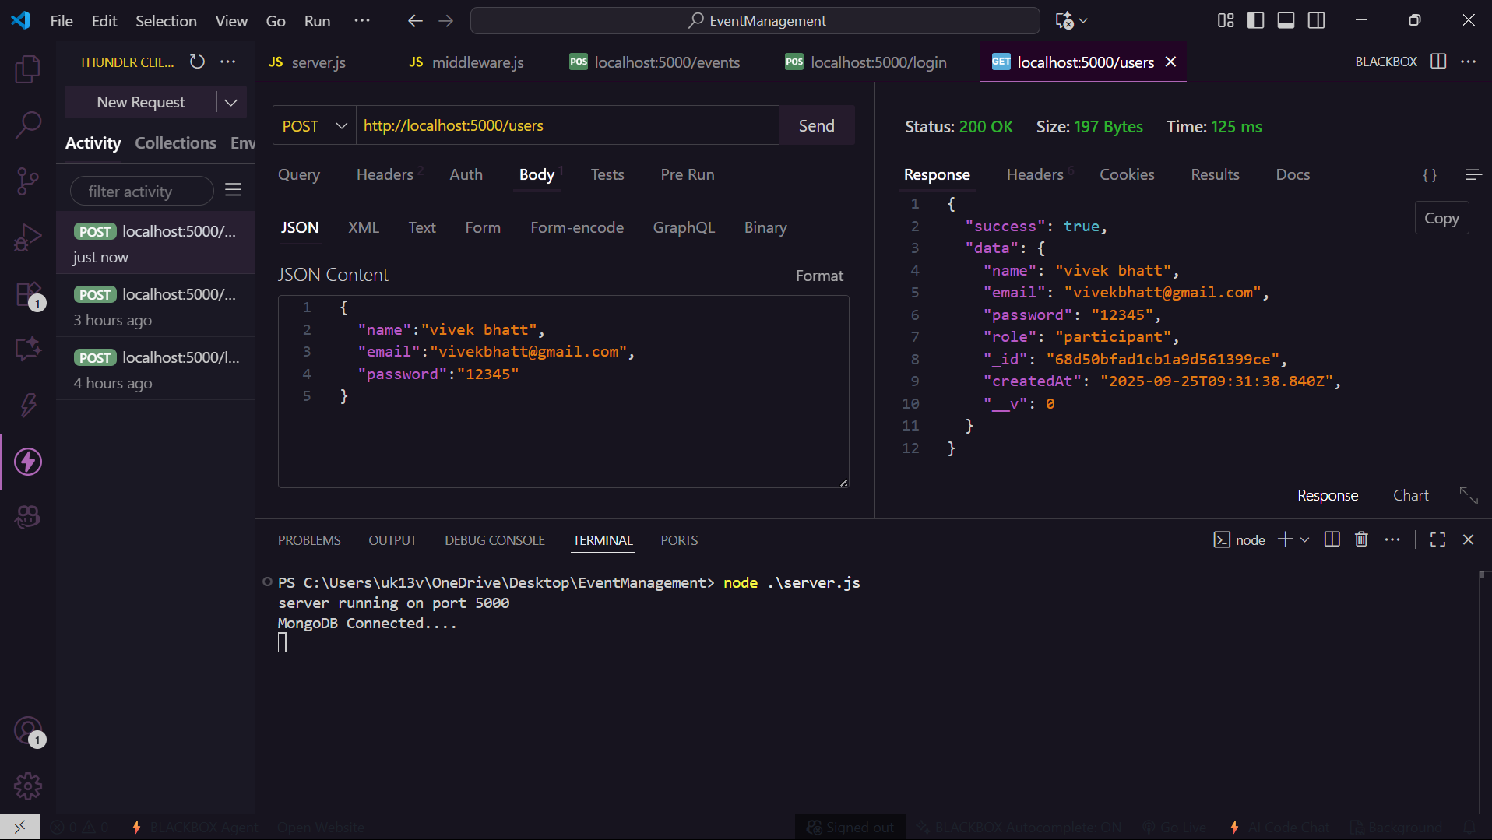
Project Highlights
Fig 1: registration of user

Slide 8
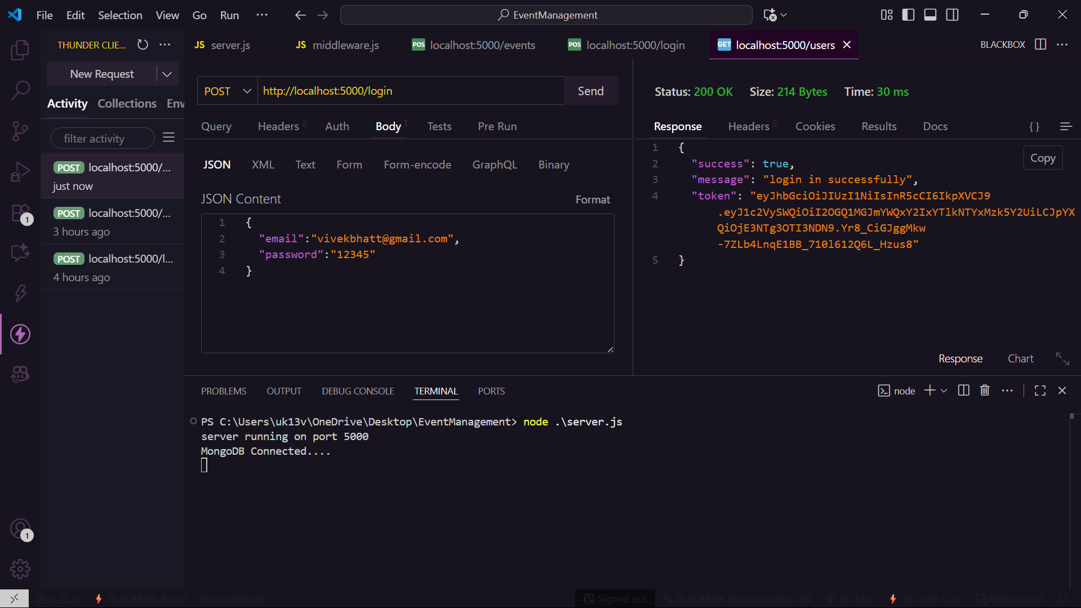
Project Highlights
Fig 2: Login of user

Slide 9
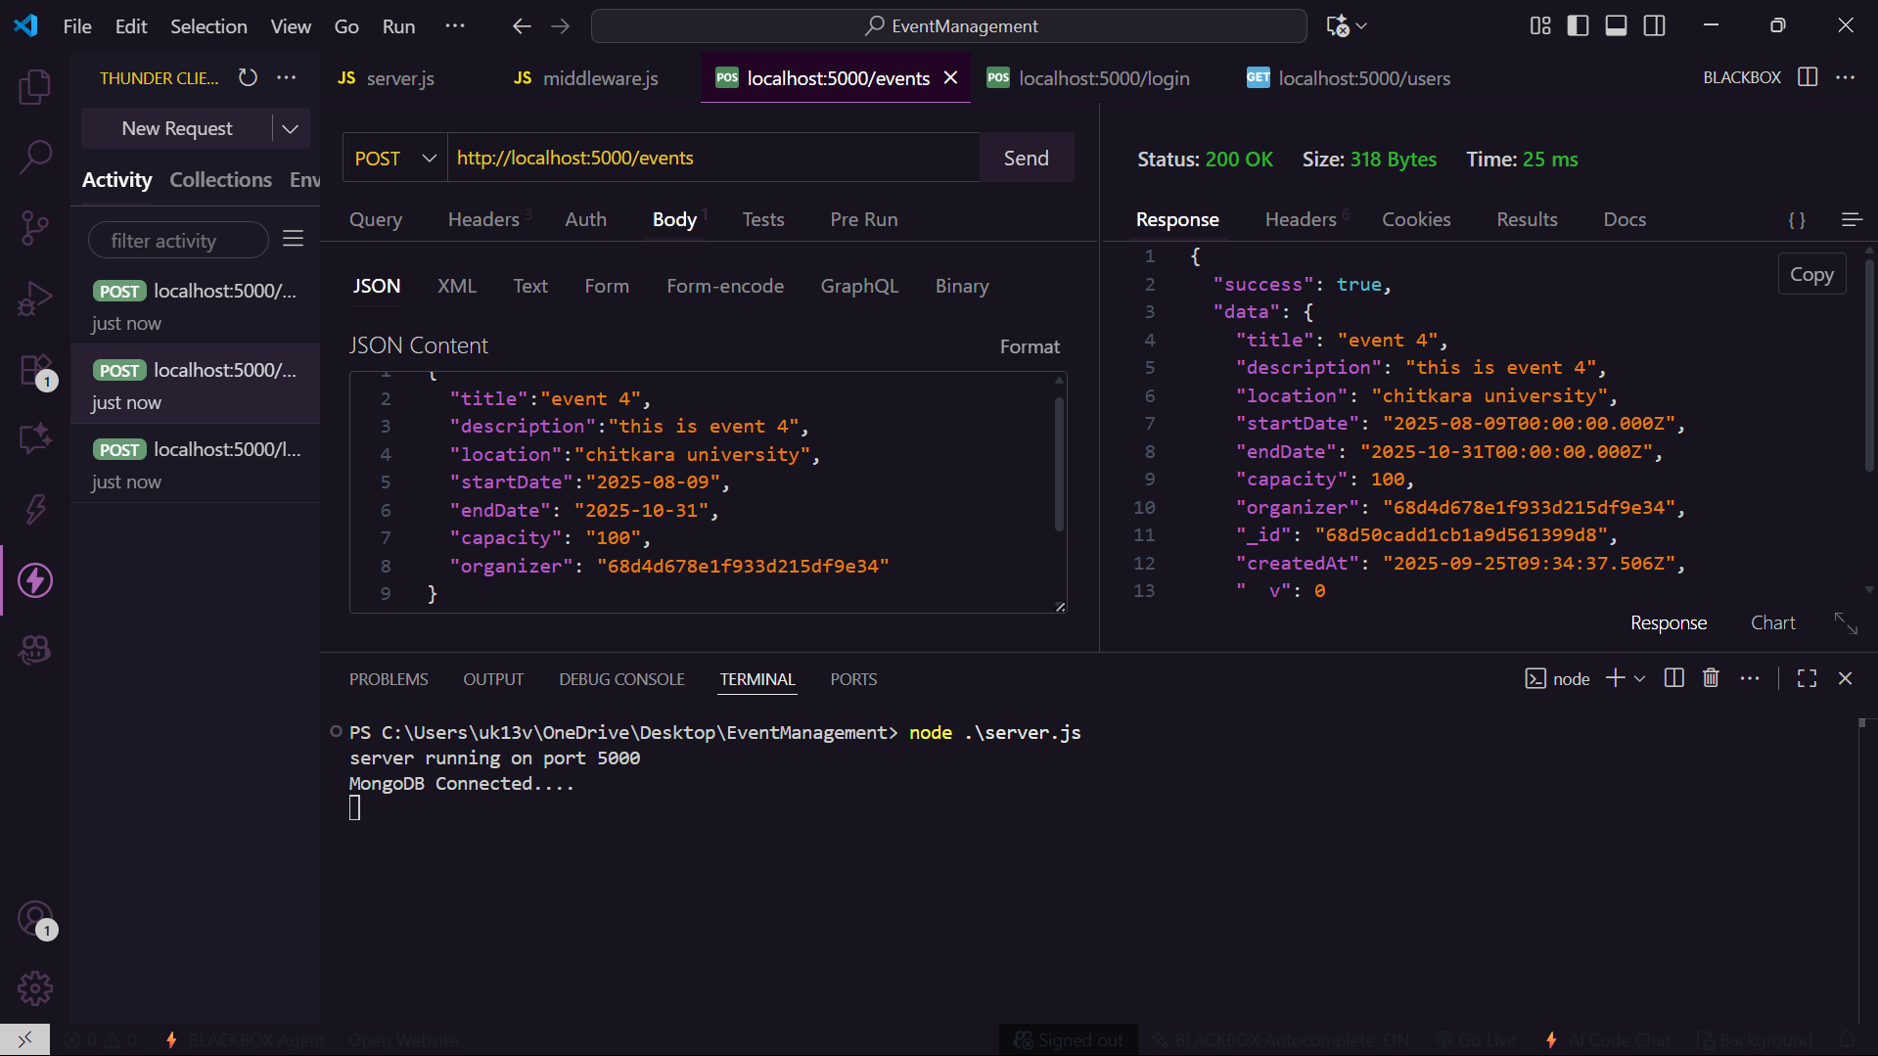
Project Highlights
Fig 3:Event creation

Slide 10
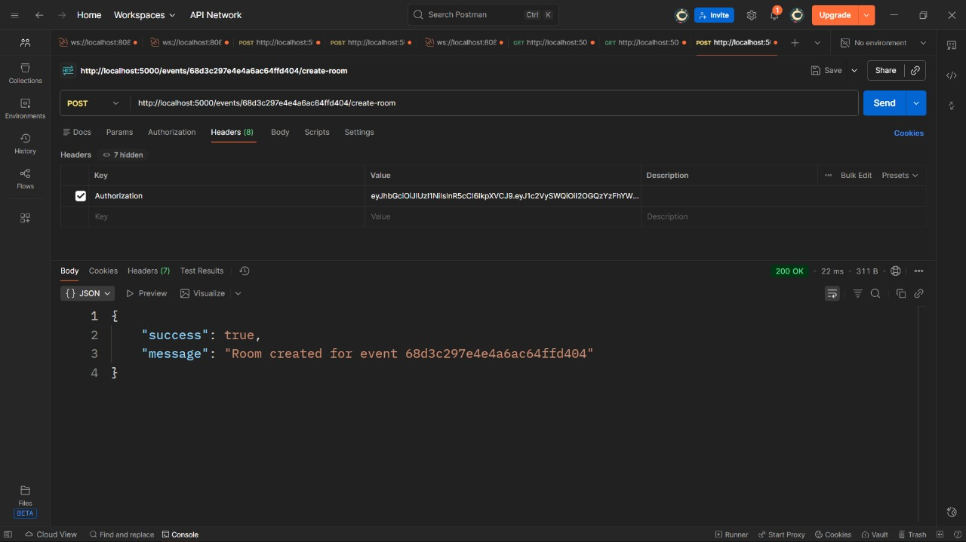
Project Highlights
Fig 4: room creation by organiser

Slide 11
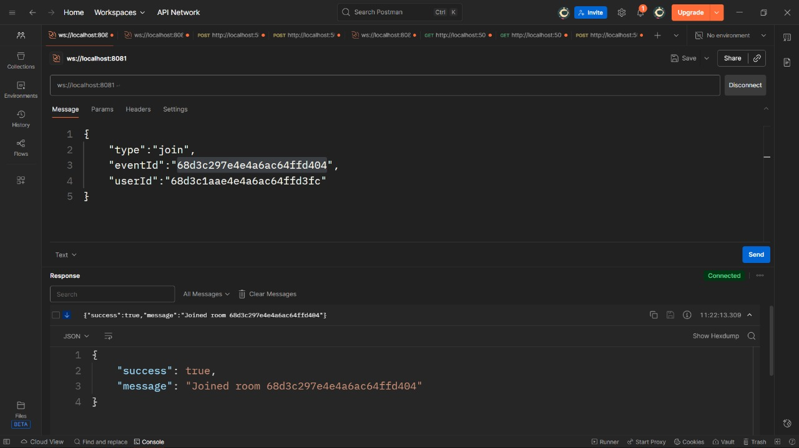
Project Highlights
Fig 5: join room

Slide 12
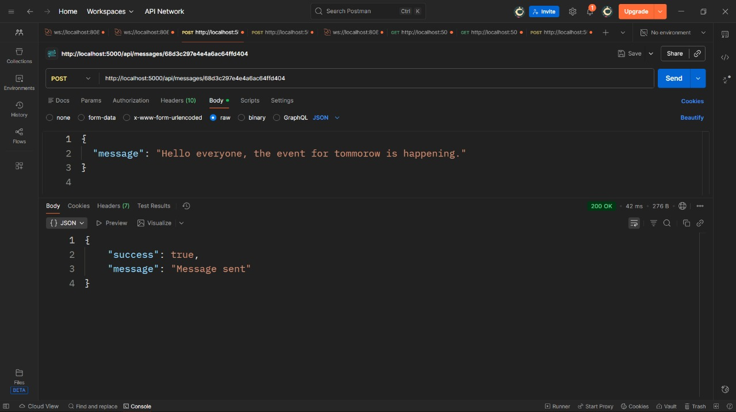
Project Highlights
Fig 6: message sent in room

Slide 13
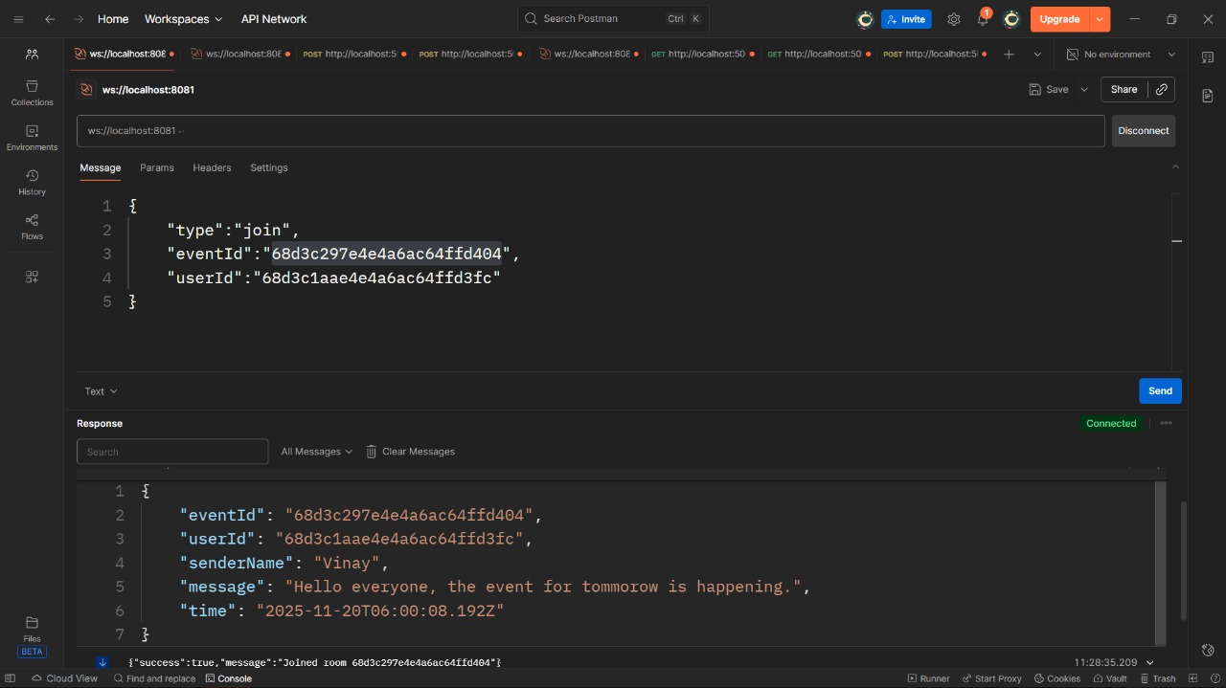
Project Highlights
Fig 7: message received by participants

Slide 14
Future Scope
Frontend Development: Build a complete, responsive frontend using React to improve user experience and make the platform more interactive.
Digital Certificates: Add a feature to automatically generate and issue verifiable digital certificates to participants after event completion.
Advanced Notifications: Implement a robust notification system using WebSockets + Redis Queue for real-time alerts, reminders, certificate updates, and event announcements across web and mobile.

Slide 15
Conclusion
Summary of the Project:
This project is a web-based Event Management System built with Node.js and MongoDB, providing a centralized and secure platform that bridges the communication gap between event organizers and students.
By integrating Redis for caching & background processing and a separate WebSocket service for real-time notifications, the system becomes fast, scalable, and highly responsive, matching modern industry standards for web applications.
Key Takeaways:
Improved Communication
Enhanced Security
Increased Efficiency

Slide 16
References/Links used
Official Documentation:
Node.js: https://nodejs.org
Express.js: https://expressjs.com
MongoDB: https://www.mongodb.com
Research & Background:
Articles on college event management challenges – Medium, ResearchGate.
Case studies of event promotion platforms and student management systems.

Slide 17


